Slide 1
MOBRO
Mobile recharge application

Slide 2


App profile
The app is a mobile recharge application created for android phones for competing with current recharge apps in the market like Paytm,PayU,etc..
MOBRO

Slide 3
Introduction
The app profiles two types of users
The busy and non-familiar users who are not interested in coupons and want simple recharges
The familiar users who want to use coupons and utilize our offers and deals

Slide 4
The Busy users
For this category of users we make a simple linear layout.
They can easily recharge their phones without random offers bugging them
No hassle ,time saving
Register an account
Enter phone number
Choose Top Up
Complete payment

Slide 5
The Familiar users
The users who want to take the benefit of the offers and discounts available
Offers on regular basis
Offers not only benefit users but their friends too thus binding the users and making them our regular customers

Slide 6
The Familiar users
Register for an account/Login
Enter your mobile number
See available offers
Choose top-up on basis of offer
Invite /Choose friend to involve in the offer and complete payment

Slide 7
Why use Mobro ??
The app will offer specialized deals to the registered users
The app will allow multiple recharges in a single transaction
The app will benefit not just the users but also their friends and relatives

Slide 8
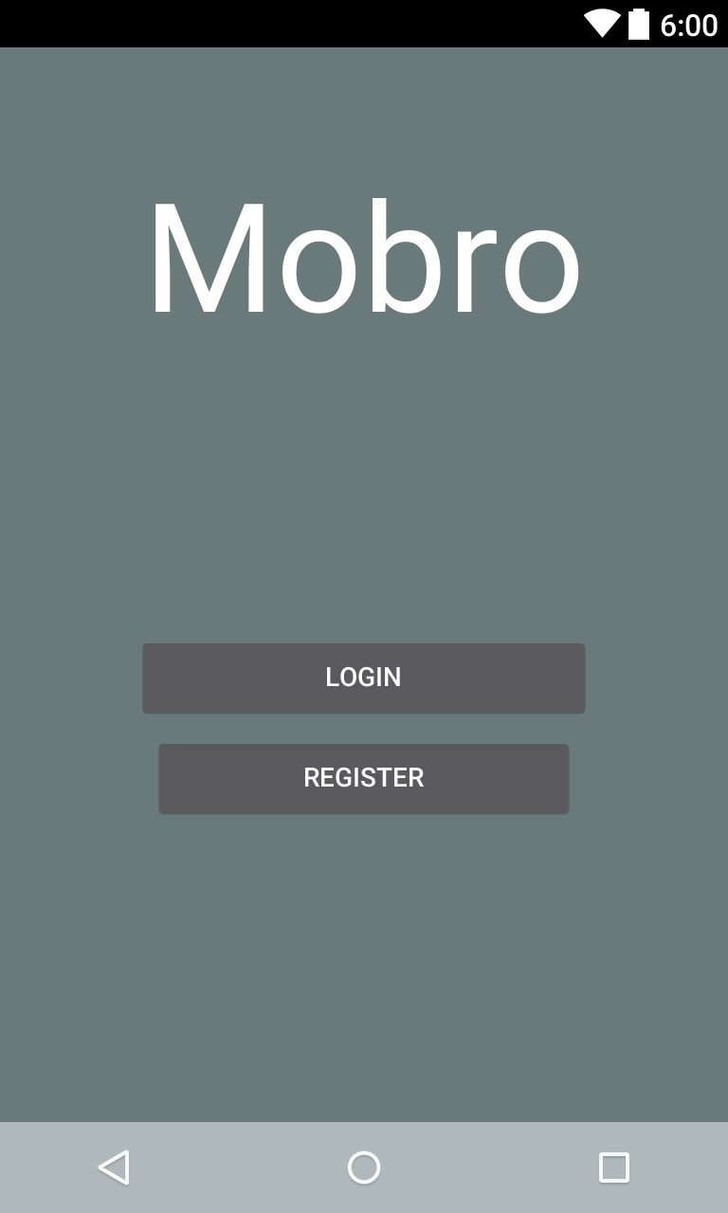
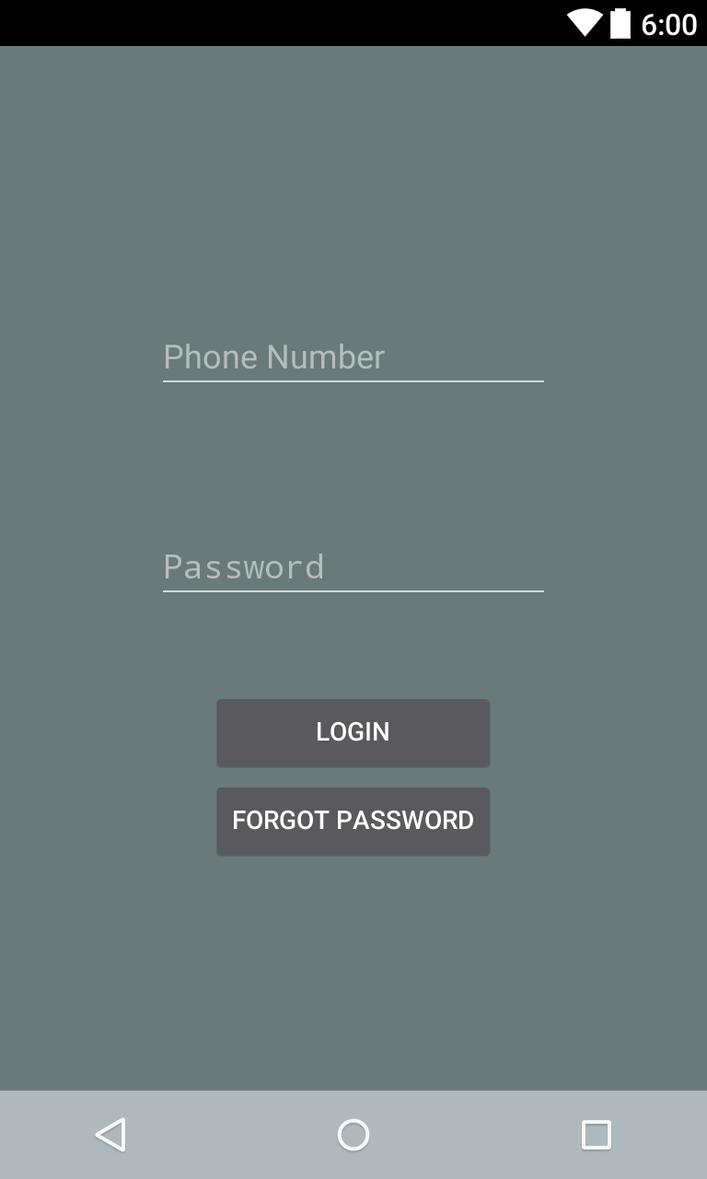
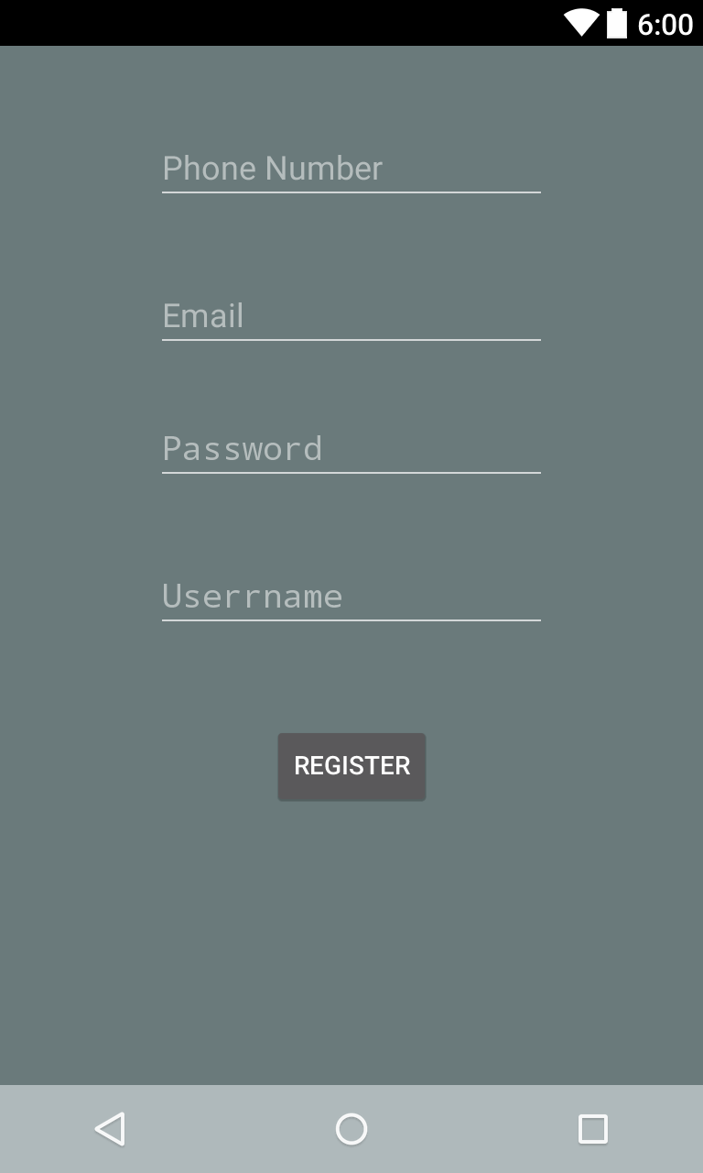
The UI design [Basic Backbone]

Slide 9
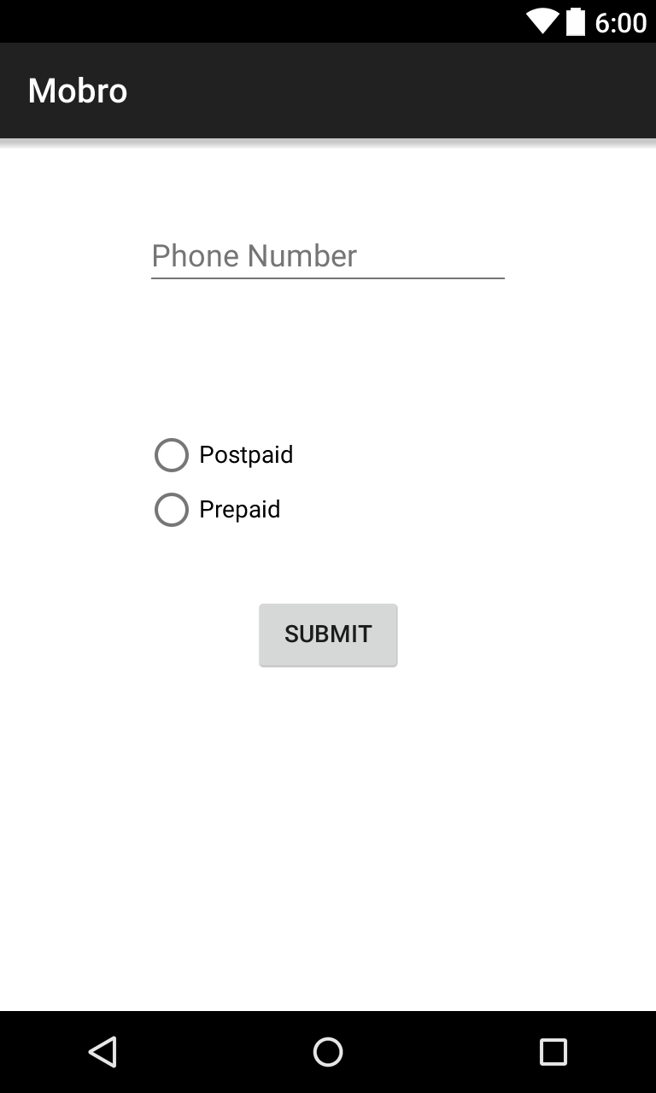
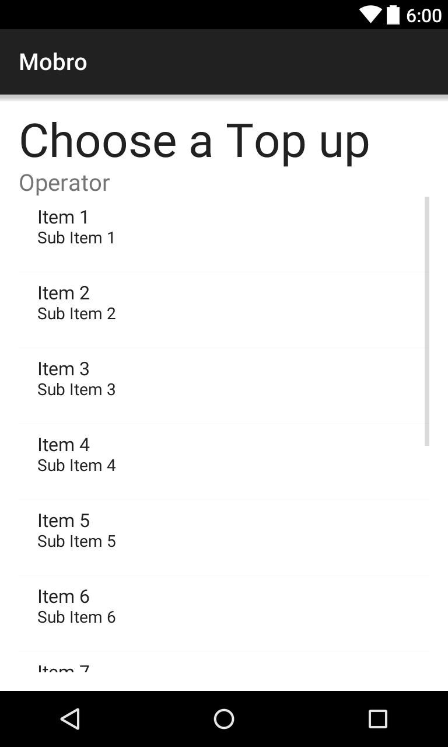
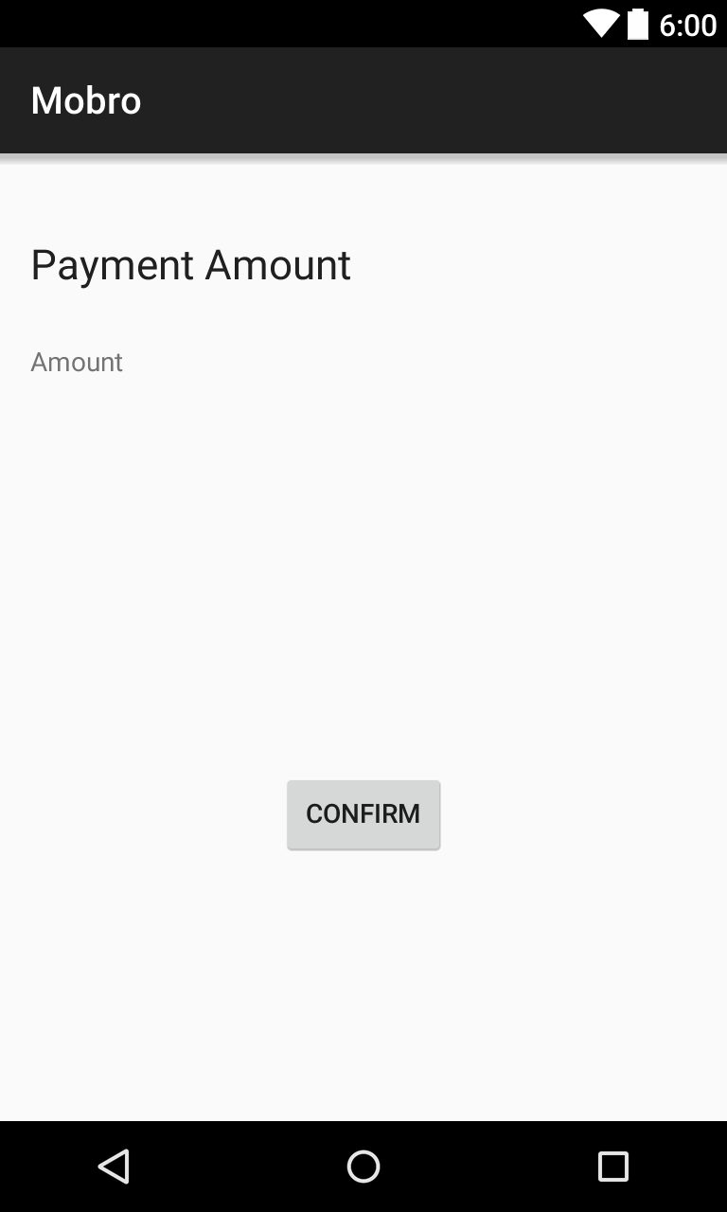
The UI design [Basic Backbone]

Slide 10
The Login API and The database
A login API was created in PHP for making contact with the database
The API is responsible for adding new users to the database
Checking if a user with the same credentials already exists
Logging the user in if given set of credentials are correct

Slide 11
The Login API and The database
The API returns response to the app in JSON format indicating the status of the request
The API resides on a web server and can be contacted using the HTTP POST requests
The database resides on a secure server to store the details of the user and

Slide 12
Identifying the operator
The application sends a request to the web server containing the PHP API which automatically detects the Operator and its Area of operation .
Not able to link it with the app due to POST API getting flushed

Slide 13
Getting the Top ups
After getting the operator and the area of operation we can get the different recharges available
The different recharges involved consist of
TOP-UPS
Full talktime
3G/2G etc..

Slide 14
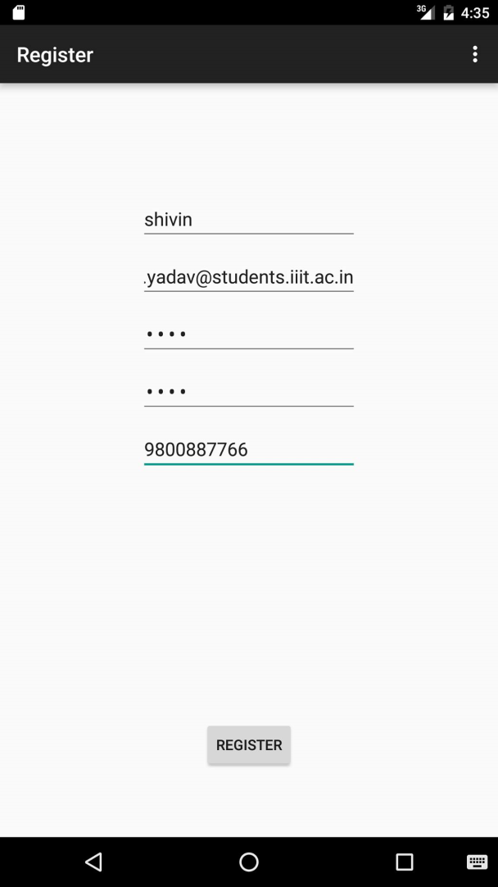
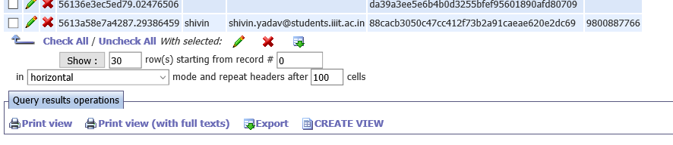
Login and Register API example responses

Slide 15
Login and Register API example responses
{"error":false,"uid":"5613a58e7a4287.29386459","user":{"name":"shivin","email":"shivin.yadav@students.iiit.ac.in","phone_no":"9800887766"}}
{"error":true,"error_msg":"User already existed with 9800887766"}
{"error":true,"error_msg":"Login credentials are wrong. Please try again!"}
{"error":false,"uid":"5613a58e7a4287.29386459","user":{"name":"shivin","email":"shivin.yadav@students.iiit.ac.in","phone_no":"9800887766"}}

Slide 16
Examples of operator and Plans API
{"opcode":"22","circode":"1","phone_no":"9899"}
{"Detail":" Rs. 900 Topup Rs.801 Talktime","Amount":"900","Validity":"Unlimited"},{"Detail":" Rs. 250 Topup Rs.219.5 Talktime","Amount":"250","Validity":"Unlimited"},{"Detail":" Rs. 160 Topup Rs.139.4 Talktime","Amount":"160","Validity":"Unlimited"},

Slide 17
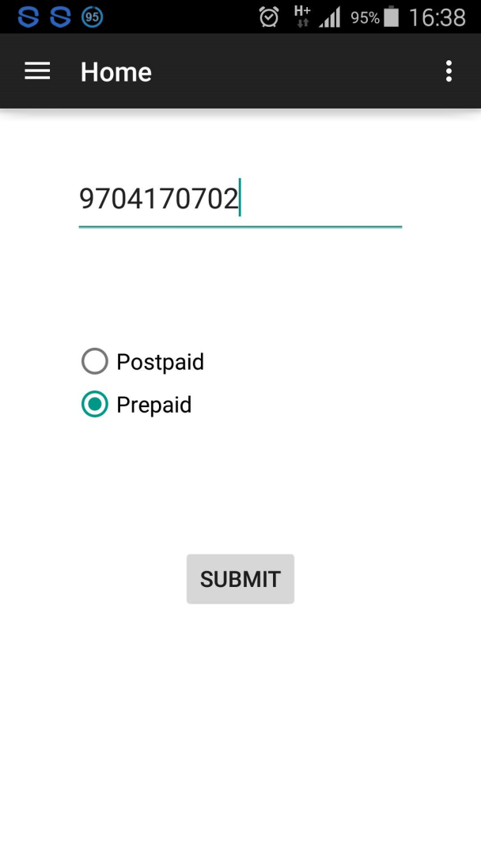
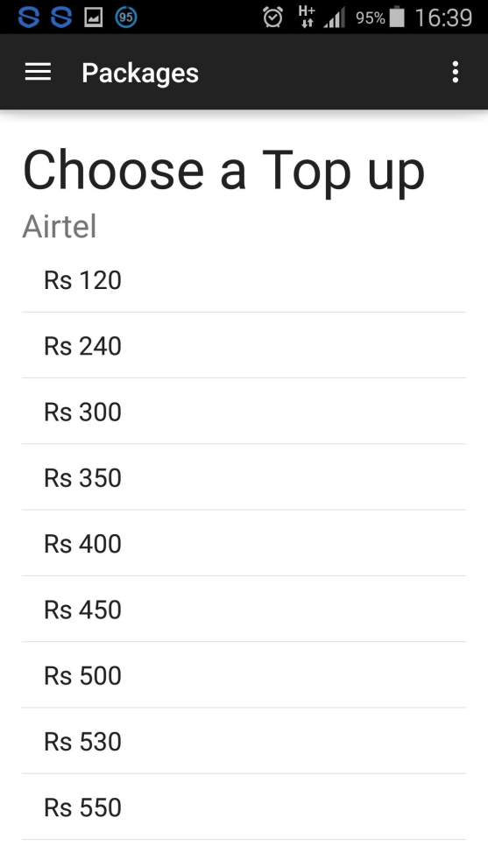
Examples of operator and Plans API

